Slide 1


RFM Segmentation in MySQL: Understanding Your Customers
This presentation will guide you through RFM segmentation. .
by KISHOR MARANDY

Slide 2
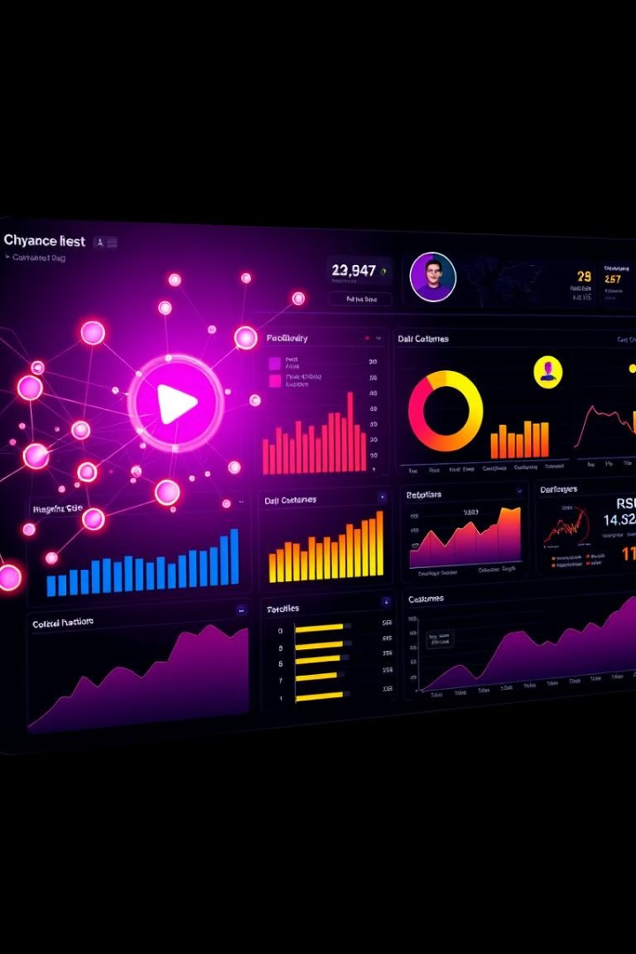
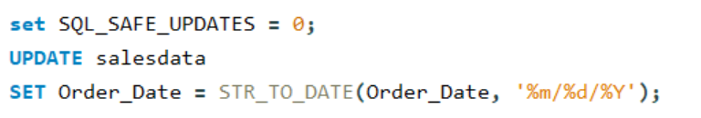
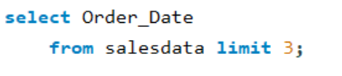
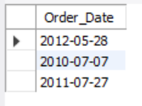
Data Exploration and Formatting Verification
UPDATE DATE FORMAT

Slide 3

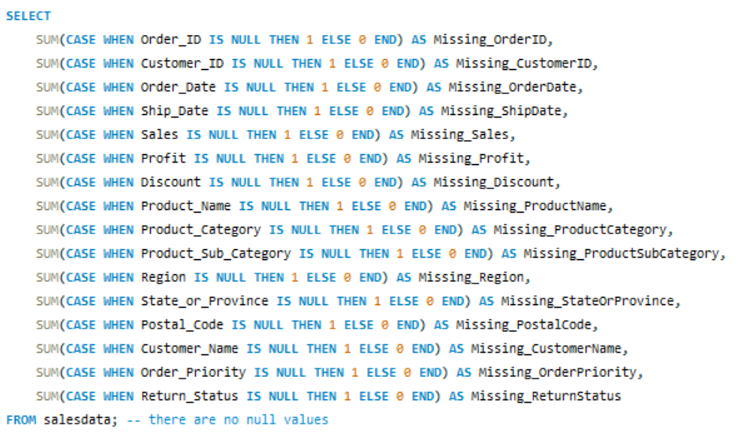
Table Schema Cleaning and Updates
1
Handling Missing/Null Values

Slide 4
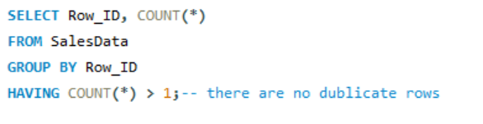
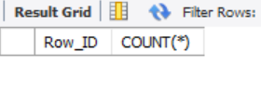
Table Schema Cleaning and Updates
2
Check for duplicate rows

Slide 5
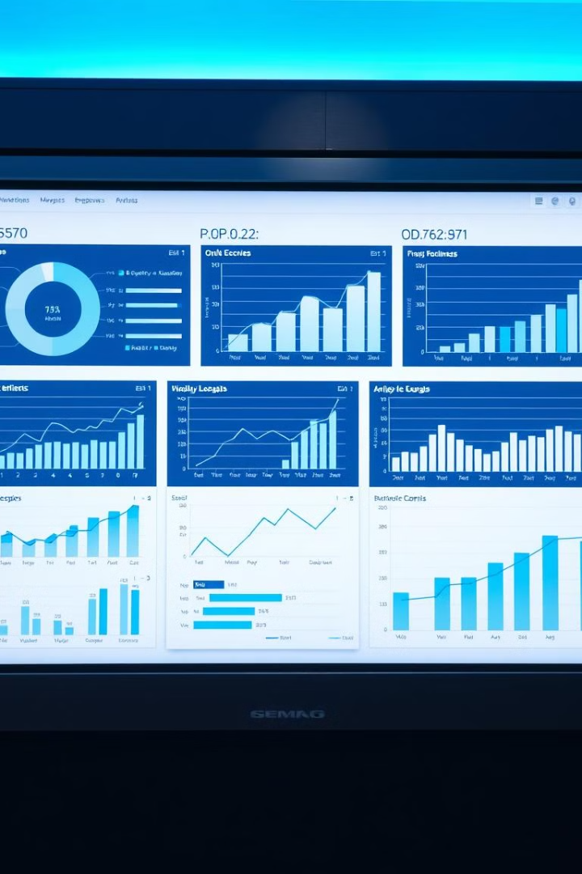

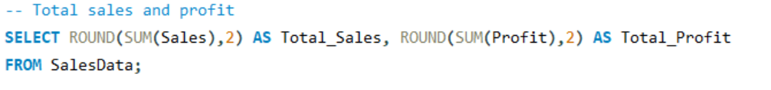
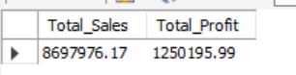
Exploratory Data Analysis
Total Sales and Profit

Slide 6

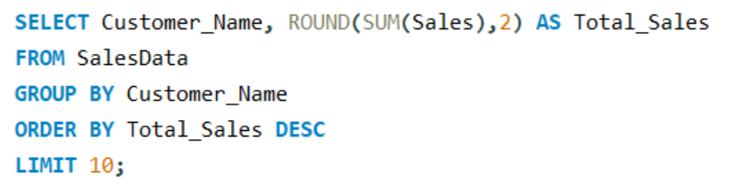
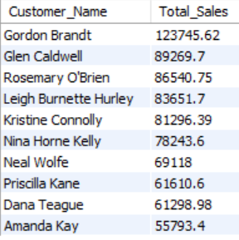
Exploratory Data Analysis
Top 10 customers by total sales

Slide 7

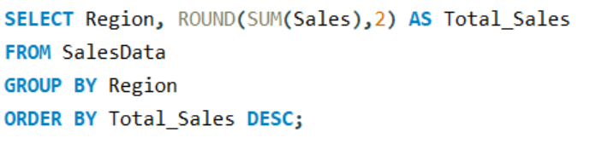
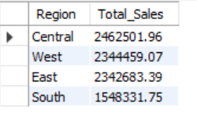
Exploratory Data Analysis
Sales distribution by region

Slide 8
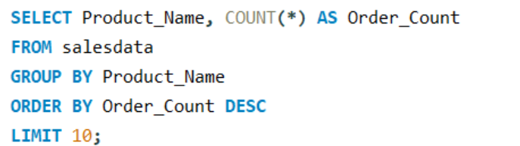
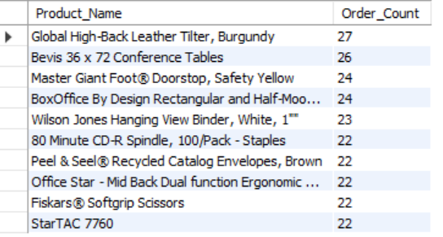
Exploratory Data Analysis
Most frequently ordered products

Slide 9
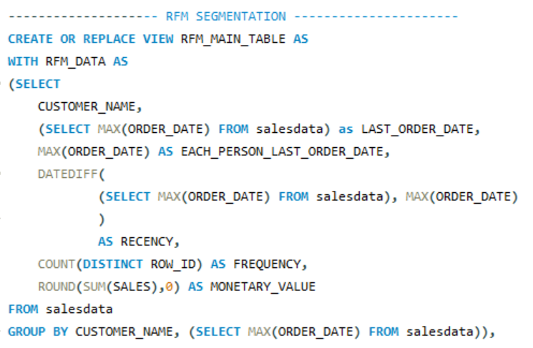
RFM Segmentation SQL Queries
1- RFM Data Preparation

Slide 10
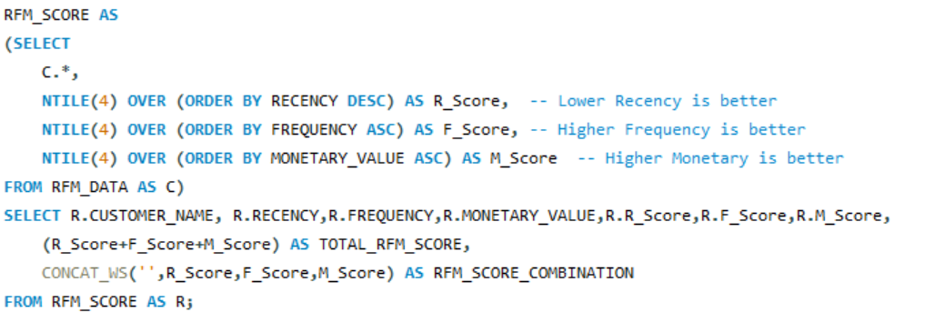
RFM Segmentation SQL Queries
2-RFM Scoring

Slide 11
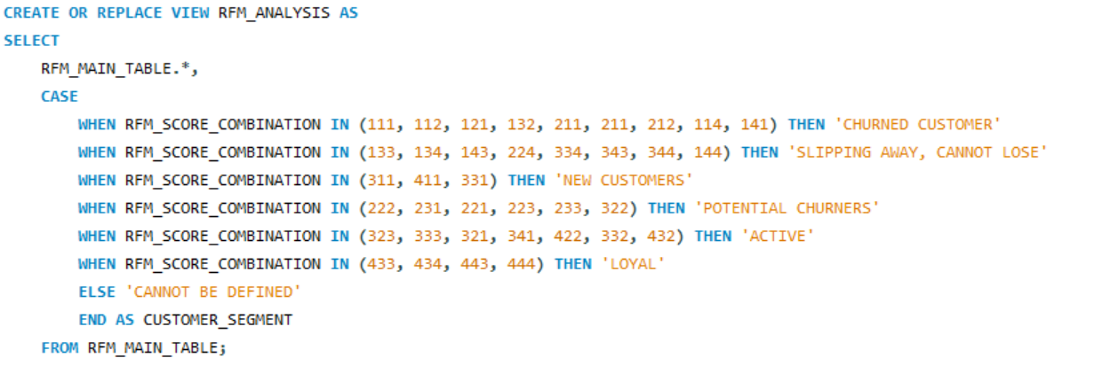
RFM Segmentation SQL Queries
3-Customer Segmentation

Slide 12
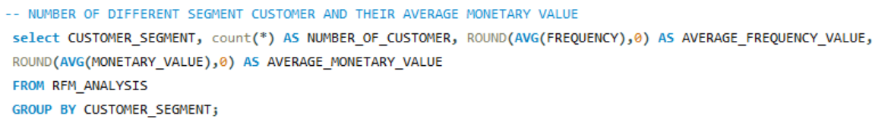
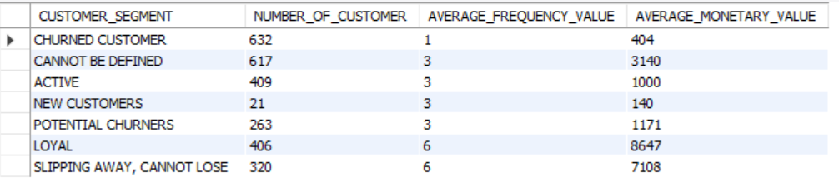
RFM Segmentation Summary

Slide 13

Customer Segmentation Strategies
Champions
Highest RFM scores. Reward loyalty.
Loyal Customers
High frequency, good spending. Engage regularly.
Potential Loyalists
Recent, frequent, moderate spenders. Offer incentives.
Lost Customers
Low RFM scores. Attempt re-engagement.

Slide 14


